Slide 1
TOURISM WEBSITE
PRESENTED TO: PRESENTED BY:
A.P. KRITIKA KAPOOR SHIVANI BHATIA(18BT140307)
KANIKA(18BT140302)

Slide 2

What Is Tourism?
Tourism refers to the act of traveling for business or leisure purposes to a location away from your hometown or usual area. It is a process of spending time away from home in pursuit of recreation, relaxation, and pleasure, while making use of the commercial provision of services.

Slide 3
WHAT IS TOURISM WEBSITE?
A tourism website usually is a Business to Customer (B2C site), whose main target are the tourists. Websites can support all the core activities of a Tourism Destination. Tourism involves the activities of people travelling and staying in a place away from their home environment for leisure, business or other purposes. Tourism was mainly been traditional in its early form. With the evolution of cultures, economies, and knowledge, tourism took a different form called sustainable tourism with the aspect of well-planned tour, well-studied destination, and conservation of destination.

Slide 4
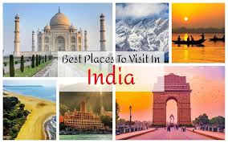
Famous places to visit In india
1. MANALI
2. SHIMLA
3. DHARAMSHALA
4. DELHI
5. AGRA
6. AMRITSHER
7. GOA
8. RAJASTHAN
9. PUNJAB etc.

Slide 5
TECHNOLOGIES USED
LANGUAGES- HTML, CSS, PHP, JAVASCRIPT
SERVER- XAMPP SERVER
DATABASE- MYSQL

Slide 6
MODULES OF TOURISM WEBSITE
1. ADMINISTRATOR MODULE
2. USER MODULE
3. GUEST MODULE

Slide 7
1. ADMINISTRATOR MODULE
This module provides administrator related functionality. Administrator manages all information and has access rights to add, delete, edit and view the data related to places, travels, routes, bookings, Enquiries etc.
It contains the following:
1. Packages 6. Manage pages
2. Users 7. Dashboard
3. Booking 8. Change password
4. Manage issues/ Complaints
5. Manage Enquiries

Slide 8
2. USER MODULE
This module provides user related functionality. It manages user personal information, user tour history and feedback.
It contains the following:
1. Sign up 5. Tour history
2. Sign in 6. Change Password
3. Forgot Password 7. Write-us
4. My Profile

Slide 9
3. GUEST MODULE
Guest user can visit the website and view the all content of website. Guest user can use Enquiry.

Slide 10
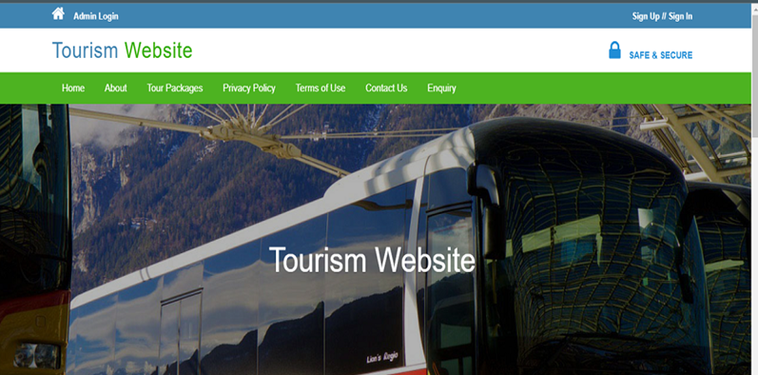
Implementation of website
HOME PAGE- The first page of our website is home page.

Slide 11
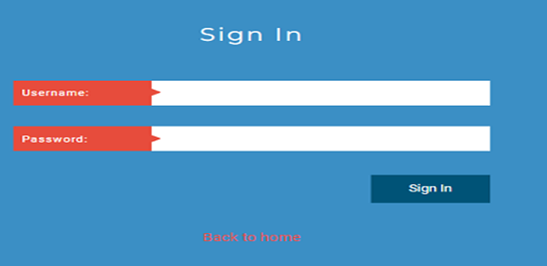
ADMIN PAGE
Admin login- Login with Admin account’s “Username” and “Password”.

Slide 12
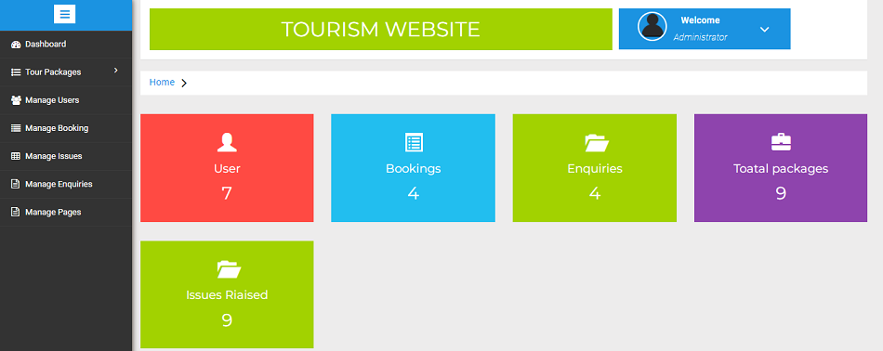
Admin block
After login with correct username and password in the admin account Admin Block is opened.

Slide 13
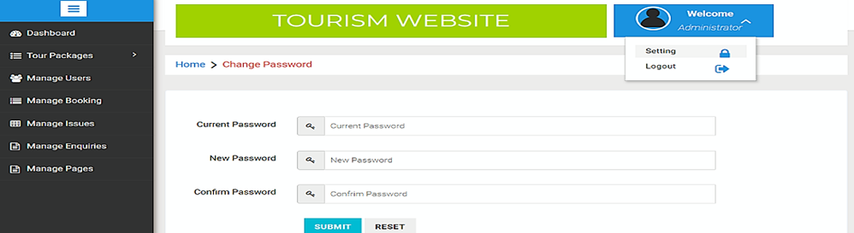

ADMINSTRATOR
Setting
logout

Slide 14
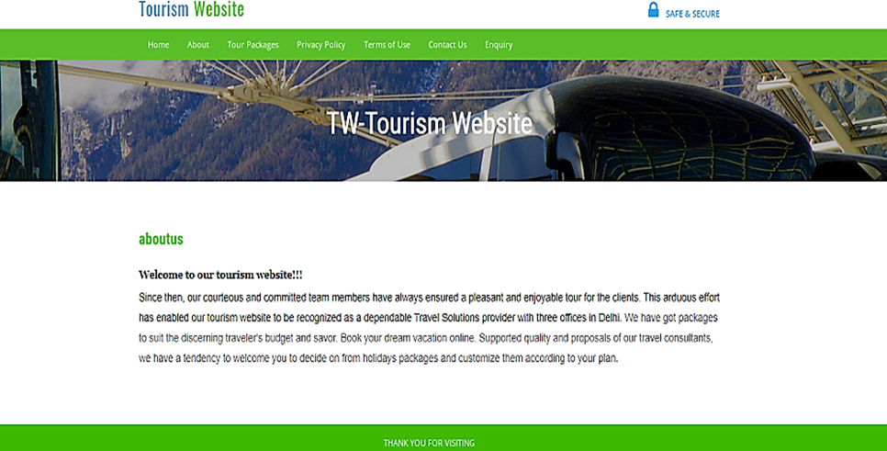
ABOUT PAGE
This page contains all the basic information abut the website.

Slide 15
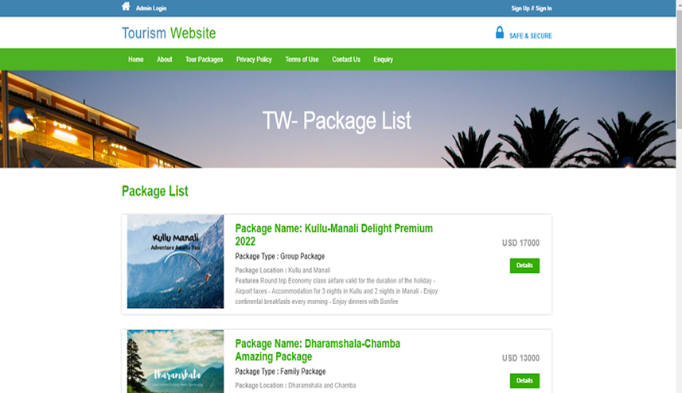
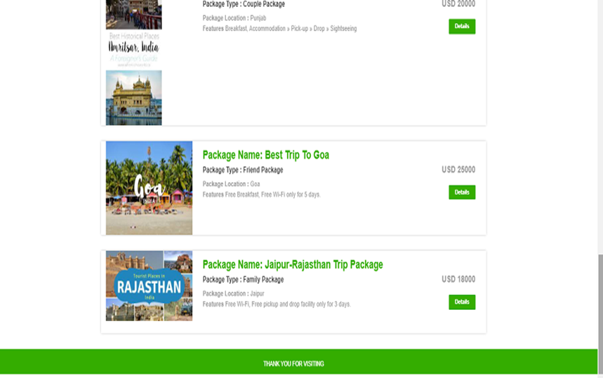
Package list
It contains the list of packages provided by the site.

Slide 16
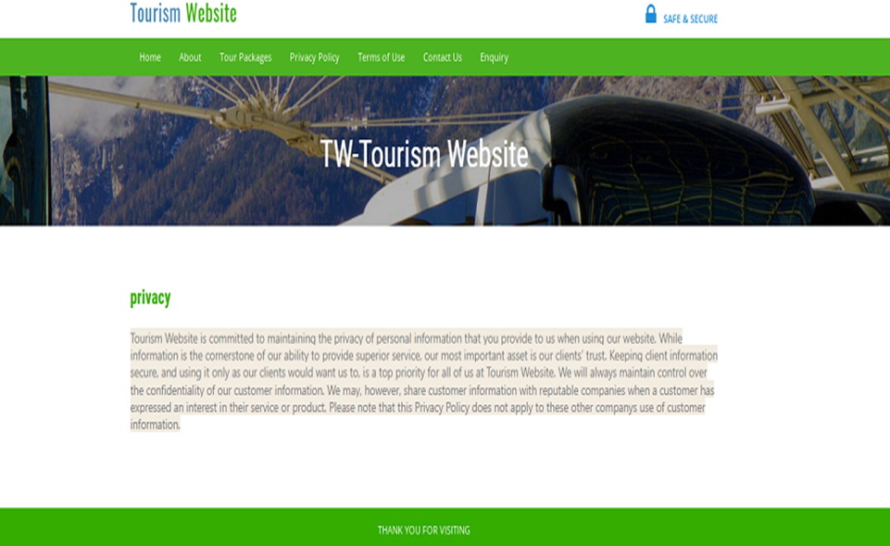
PRIVACY POLICY PAGE
It contains the privacy policies of website.

Slide 17
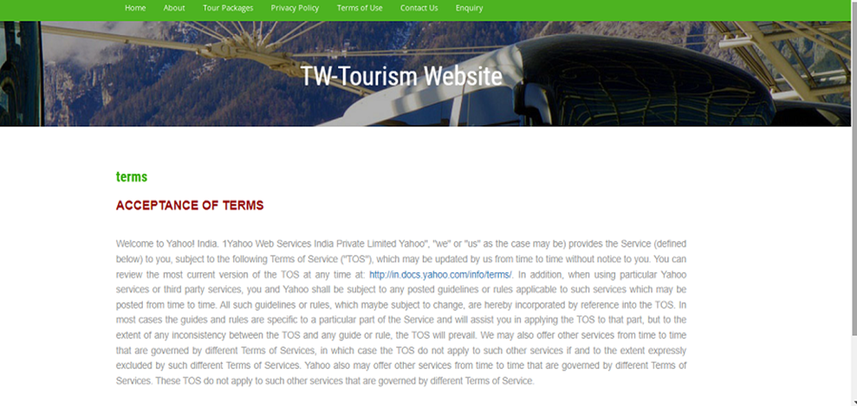
TERM OF USE
This page contains how to use the website in appropriate way.

Slide 18
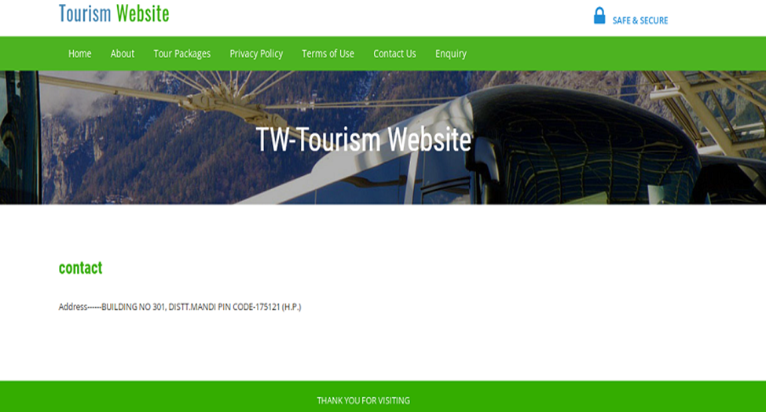
CONTACT US
This page contains contact address of the admin.

Slide 19
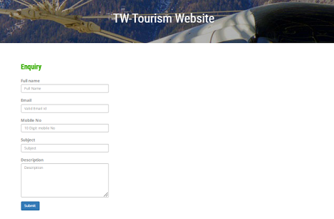
ENQUIRY
Using this option user can put any type of enquiry and submit it to the admin.

Slide 20
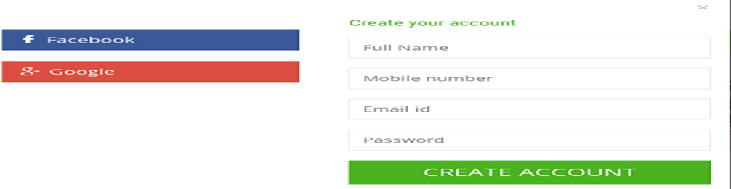
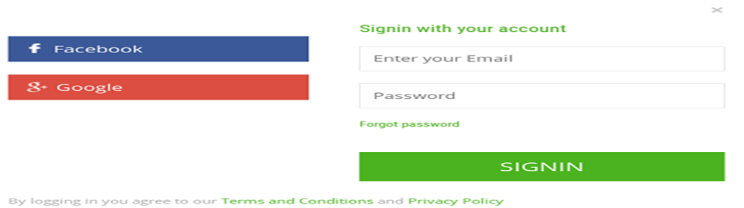
SINGN UP // SIGN IN
SIGN UP
Sign in
This block is used to create a new account on the website.
This block is used to sign in to the website if you already have an account in this website.

Slide 21
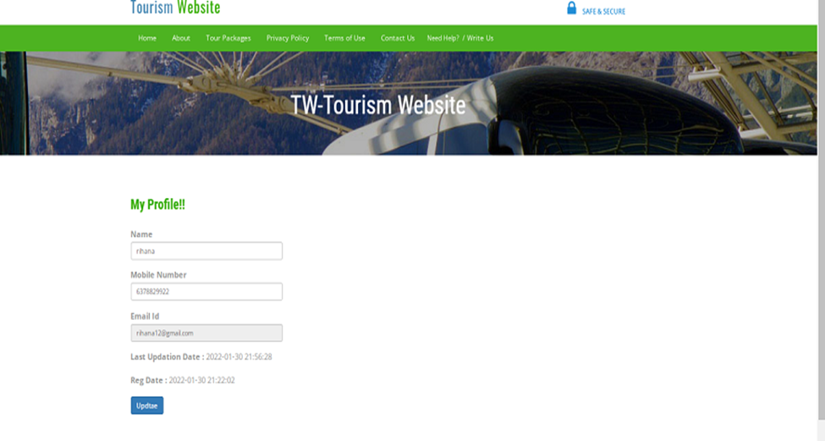
Sign in MY PROFILE
If user have logged in to the website then he can make any updates in his profile by clicking on the MY PROFILE option.

Slide 22
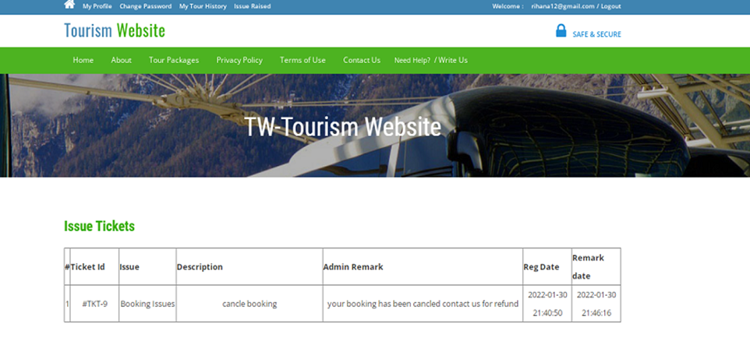
ISSUE RAISED
User can raise any kind of issues and submit it to the admin with this option.

Slide 23
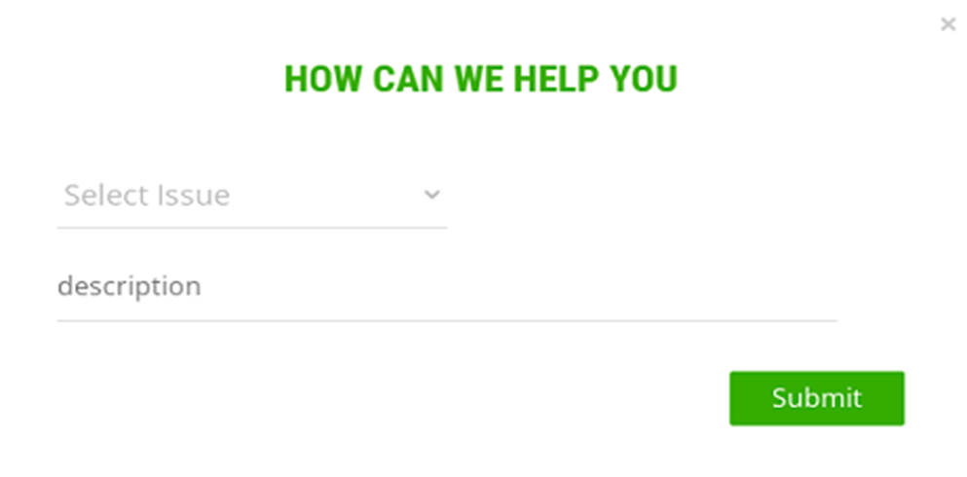
WRITE US
User can give any feedback by clicking on this option.

Slide 24
LOGOUT
After visiting your profile you simply click on logout button to come back to home page.

Slide 25
FUTURE ENHANCEMENT
1.Pilgrimage tourism: Harmony in diversity; this can best be experienced when in India. The country is laid out with plenty of religious destinations creating immense exposure for pilgrimage tourism.
2. Eco tourism: It is something new in Indian tourism sector, which invites tourist to visit and explore various locations without impacting its fragile ecosystem.
3. Youth tourism: This kind of tourism is specifically targeted for the youth travellers, who not only enjoy exploring new places but very adventure enthusiasts as well.
4. Agricultural tourism: Agricultural tourism or agritourism is a rapid growing sector today, which invites travelers to visit and explore various agricultural properties, farms, wineries and ranches.
5. Cultural tourism: One should visit India to witness its cultural diversity. India is full of fiestas and traditional practices all round the calendar making the country one of the worth visiting destinations across the globe.

Slide 26
Thank you

